Slide 1
Storyboarding CIN paper

Slide 2
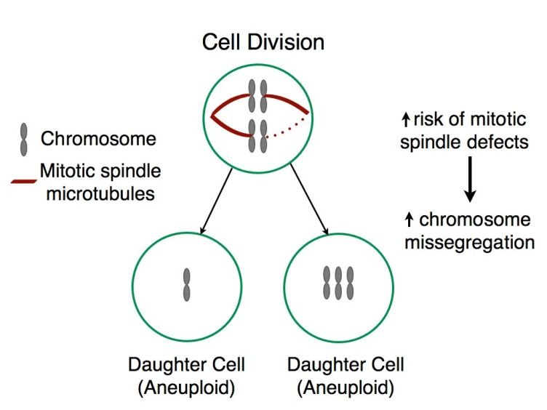
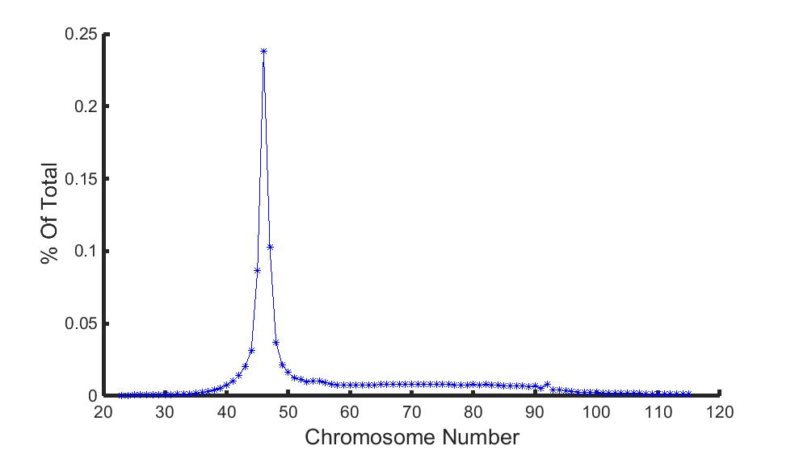
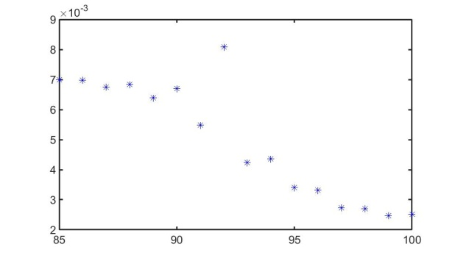
A.
B.
Low alteration rate
High alteration rate
Population
Fitness
Traits
C.
Fig. 1. CIN is a cancer phenotype that is subject to evolutionary pressures.
a) Chromosomal instability (CIN) arises from elevated rates of chromosome missegregation, which can lead to a heterogenous aneuploid population. b) Increasing error rates such as missegregation can allow the population to sample many potential phenotypes, but pushing the error rate too high can keep the population from maintaining a relatively high level of fitness leading to population collapse. This phenomenon, error catastrophe, has been demonstrated in viral evolution. c) Tumor cells have heterogenous karyotypic phenotypes

Slide 3
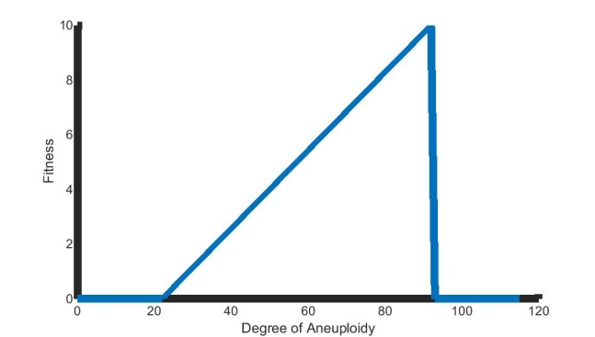
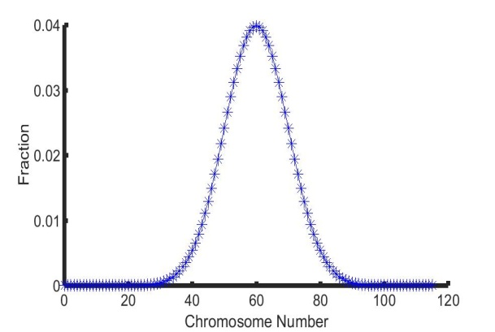
Showing underlying distributions -> different outcomes

Slide 4
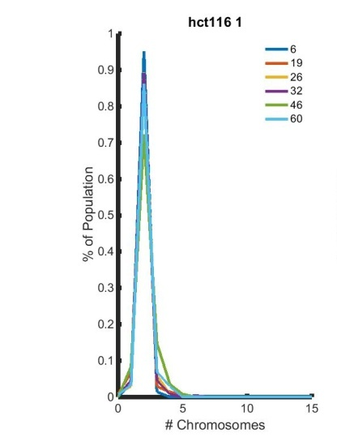
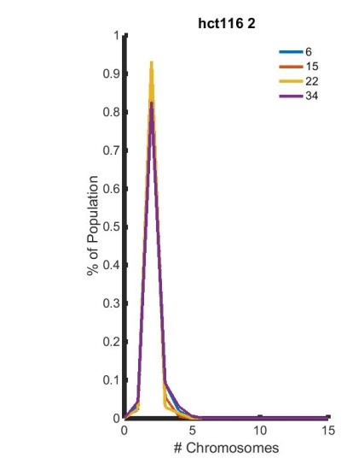
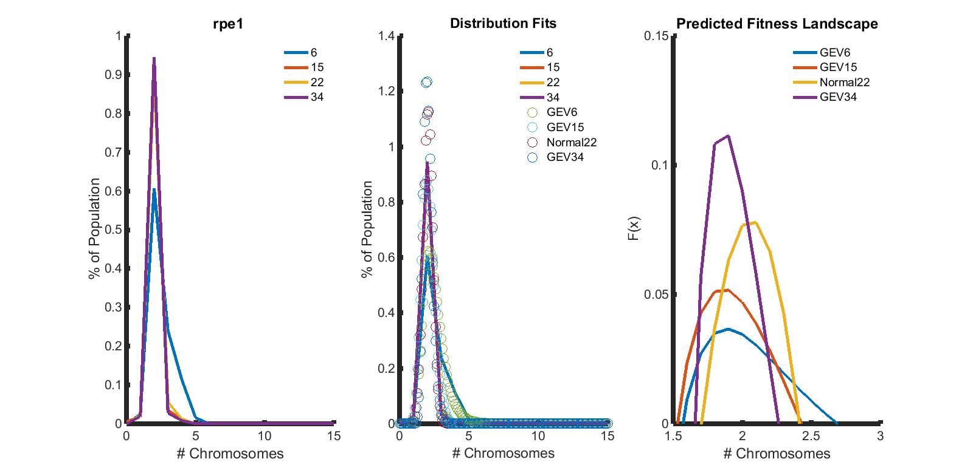
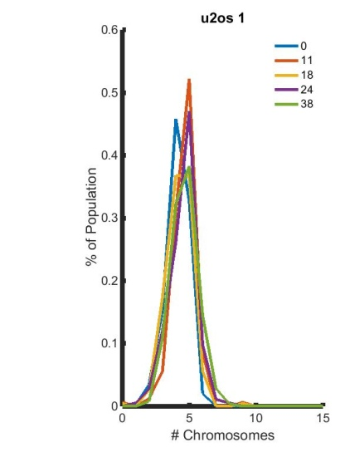
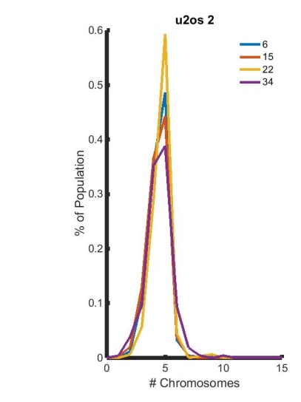
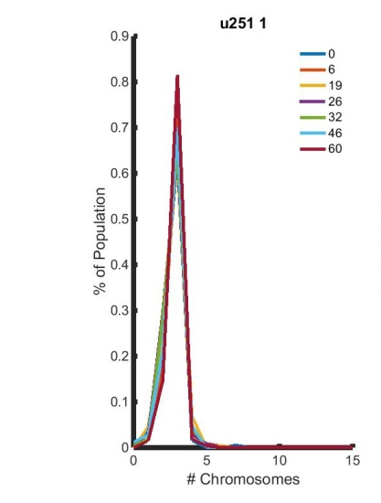
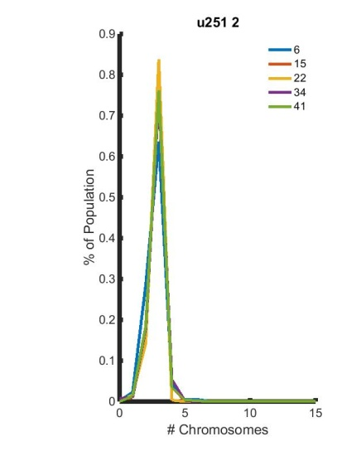
A.
B.
C.
Non-CIN
D.
E.
F.
G.
CIN
Fig. 2. CIN cancers give rise to karyotypically heterogenous populations that display steady-state. FISH was used to obtain copy numbers for chromosome 10 in a population derived from: a,b) two samples of HCT116 cells, c) RPE1 cells, d-e) U20S cells , and f-g) two samples of U251 cells. Different colors represent timepoints in days.
Notes:
Have FISH explanation/example as A/B

Slide 5
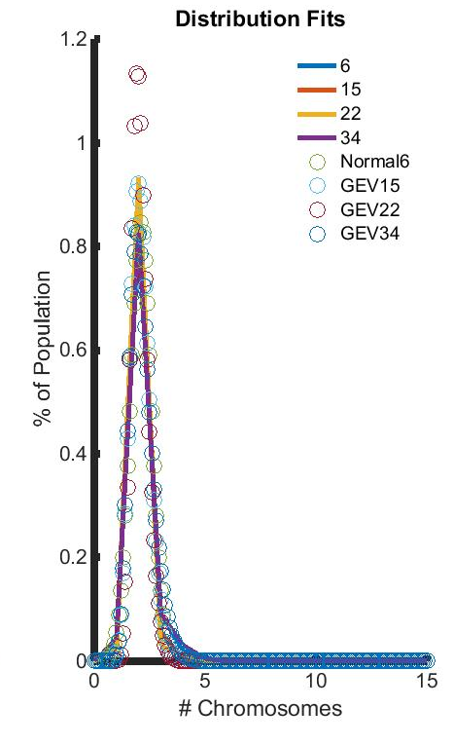


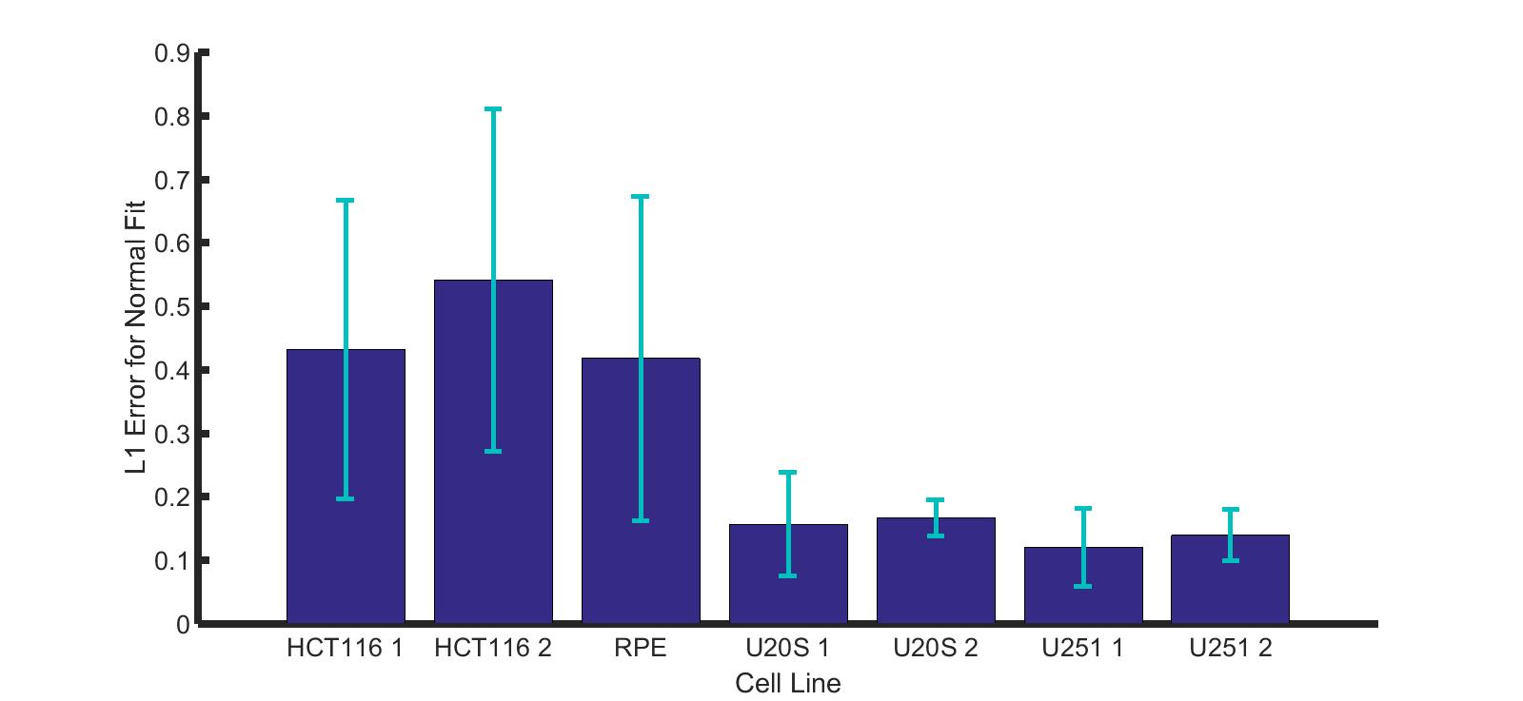
A.
B.
C.
D.
E.
Figure 3: CIN and non-CIN cell lines display fundamental difference in karyotypic distributions. Each chromosomal count histogram was fit using Matlab’s fitting toolbox; example fits are shown for a) HCT116, b) RPE1, c) U20S, and d) U251 with color representing timepoints, data represented by straight lines, and fits by using circles. The best fit for each time point histogram is shown and labeled either as a normal distribution or as a generalized extreme value (GEV) distribution. e) The error when fitting a normal distribution to non-CIN and CIN lines, with CIN lines being better fit by Gaussians (p < 0.05).

Slide 6
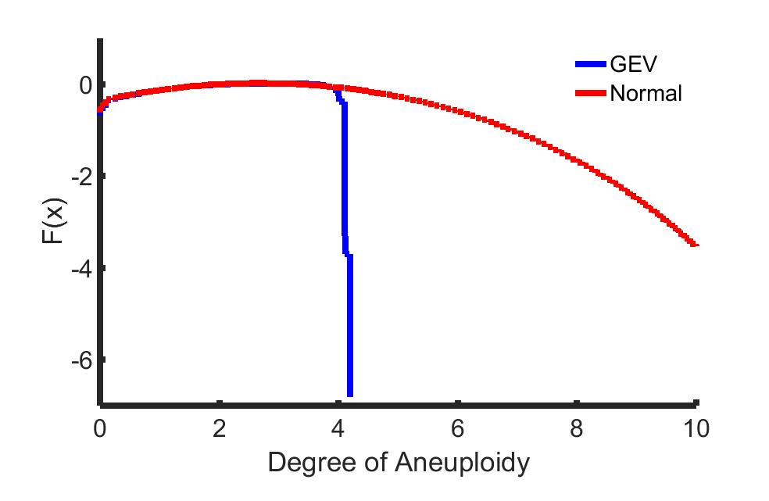
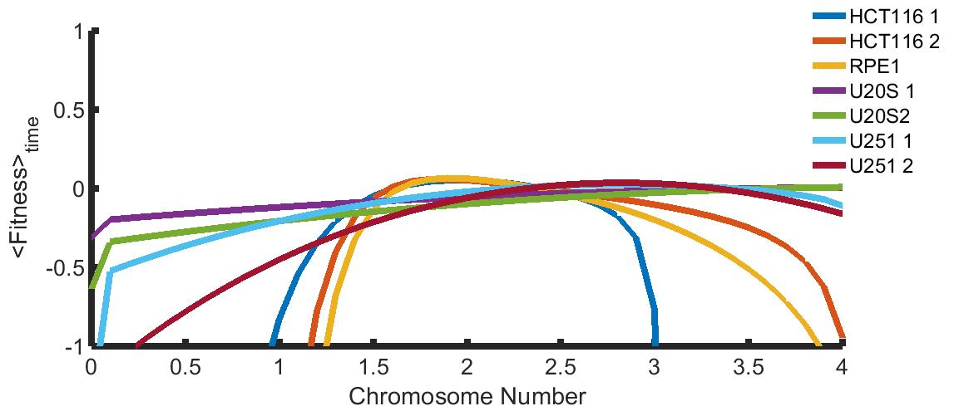
A.
B.
Figure 4: Non-CIN cell lines are predicted to be more intolerant of karyotypic heterogeneity. a) Sample fitness landscapes derived from distributions fit by a Gaussian (red) or a generalized extreme value (GEV). CIN lines are better fit by normal distributions (Fig. 3e), which also lack the steep drop-off found in GEV-based landscapes. b) Time-averaged fitness landscapes for 3 non-CIN lines (HCT116 trials 1 and 2 and RPE1) and 4 CIN lines (U20S trials 1 and 2, U251 trials 1 and 2). CIN lines display flatter fitness landscapes.

Slide 7
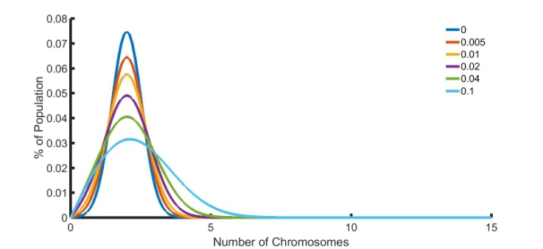
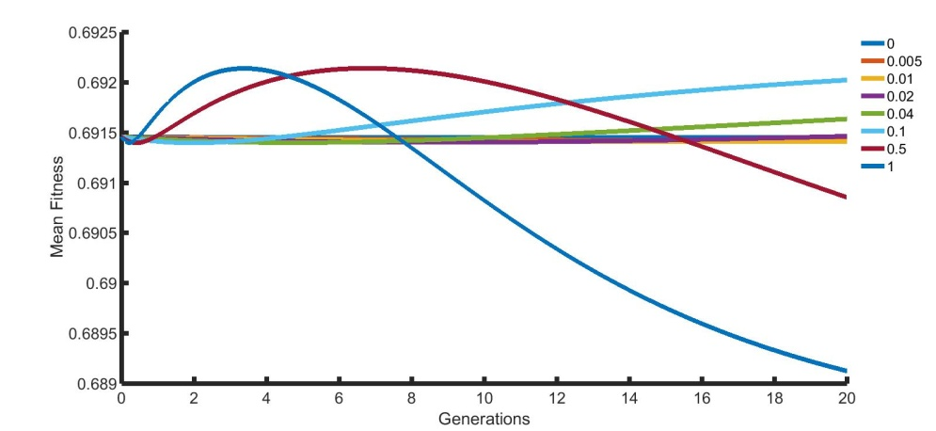
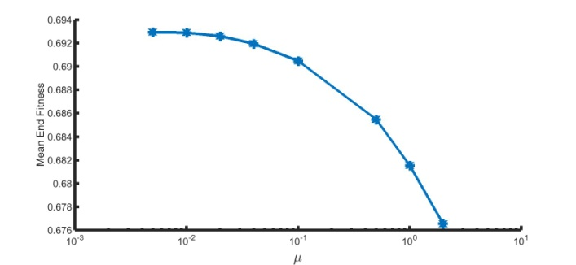
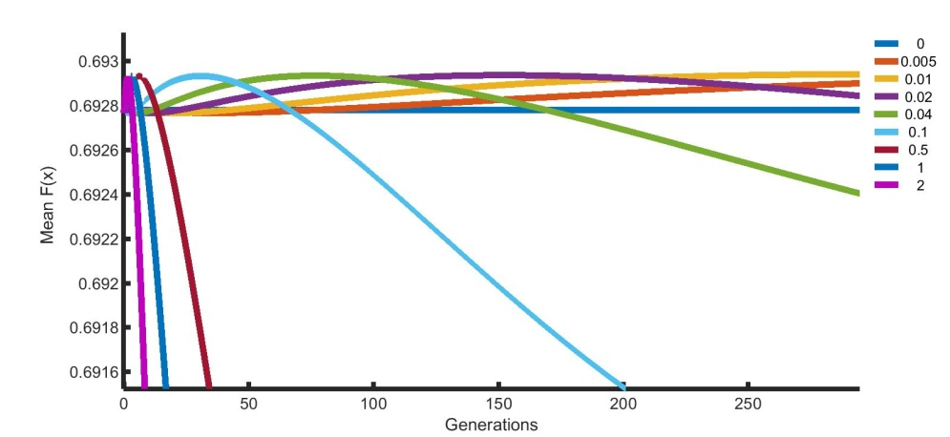
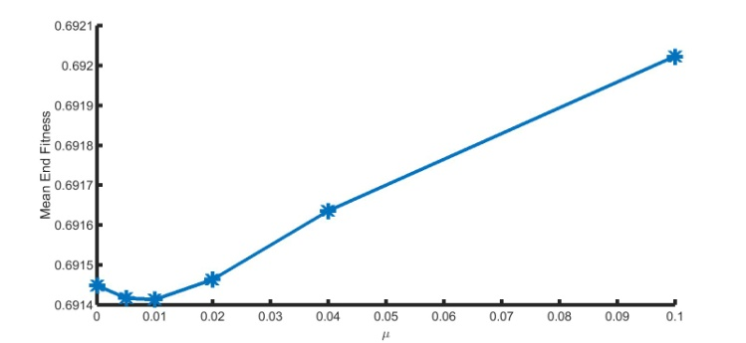
A.
D.
B.
E.
C.
Figure 5: CIN lines have a very high error threshold before succumbing to error catastrophe.
A sample fitness landscape from U251 was used to simulate population dynamics as a result of changing missegregation rate. a) The population distribution flattens as missegregation rate is increased (colors represent different rates). b) After simulating for 10 generations, mean end fitness declines with increasing missegregation rate. However, allowing the simulation to run for >100 generations, as in c), actually results in increased overall fitness. Simulations allowed to run for d) 20 generations and e) 300 generations (including an additional missegregation rate), indicate that either large timescales or large missegregation rates are necessary to substantially decrease mean fitness.

Slide 8
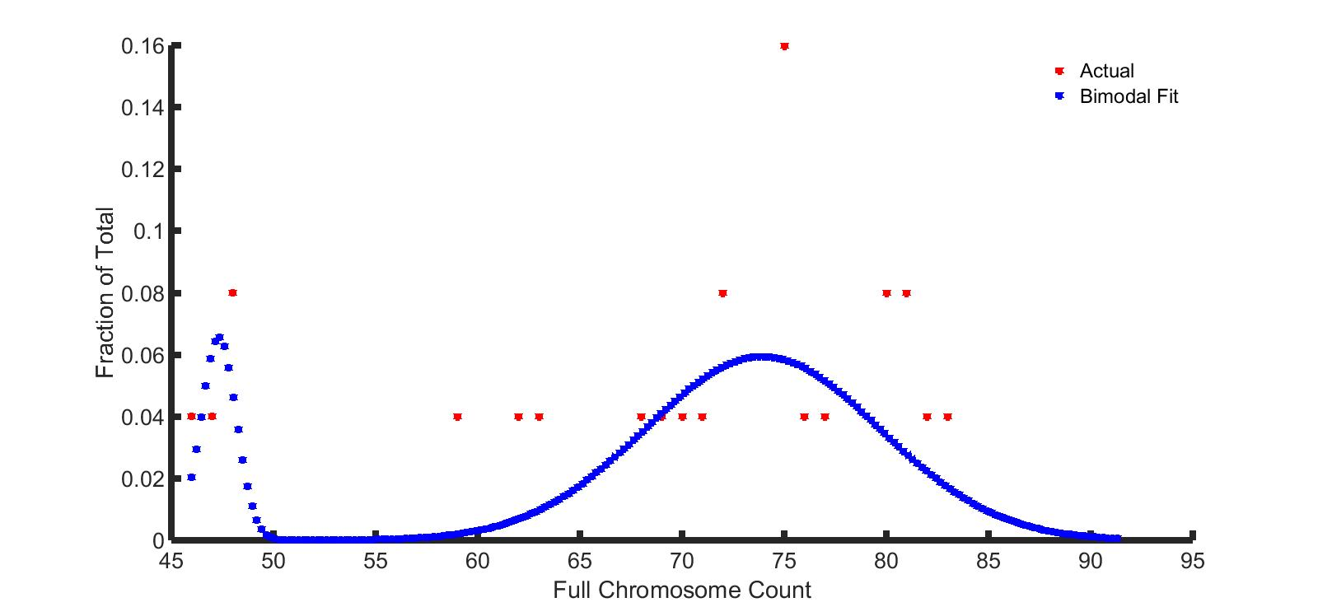
SKY data exhibits bimodality

Slide 9
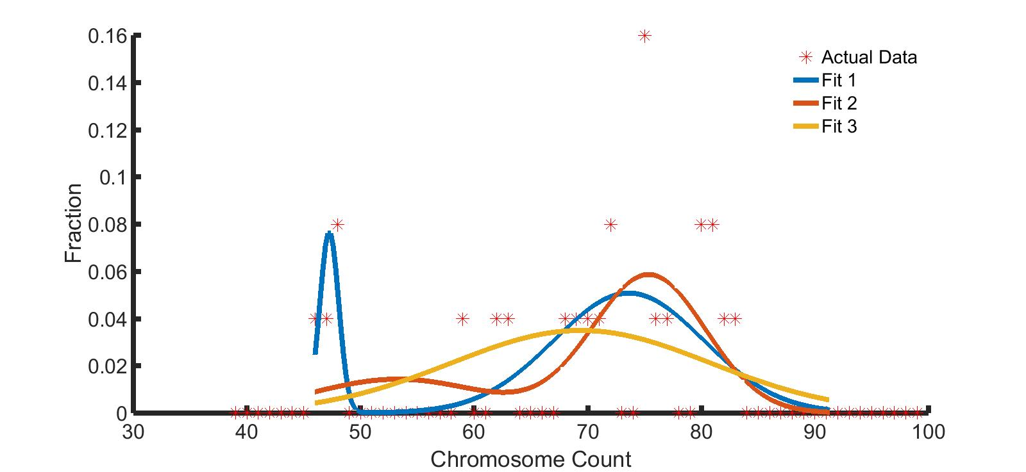
How good is our fit?
99% give Fit 1 (least error) for 456 trials
  Other fits have difficulty w/ bimodality

Slide 10
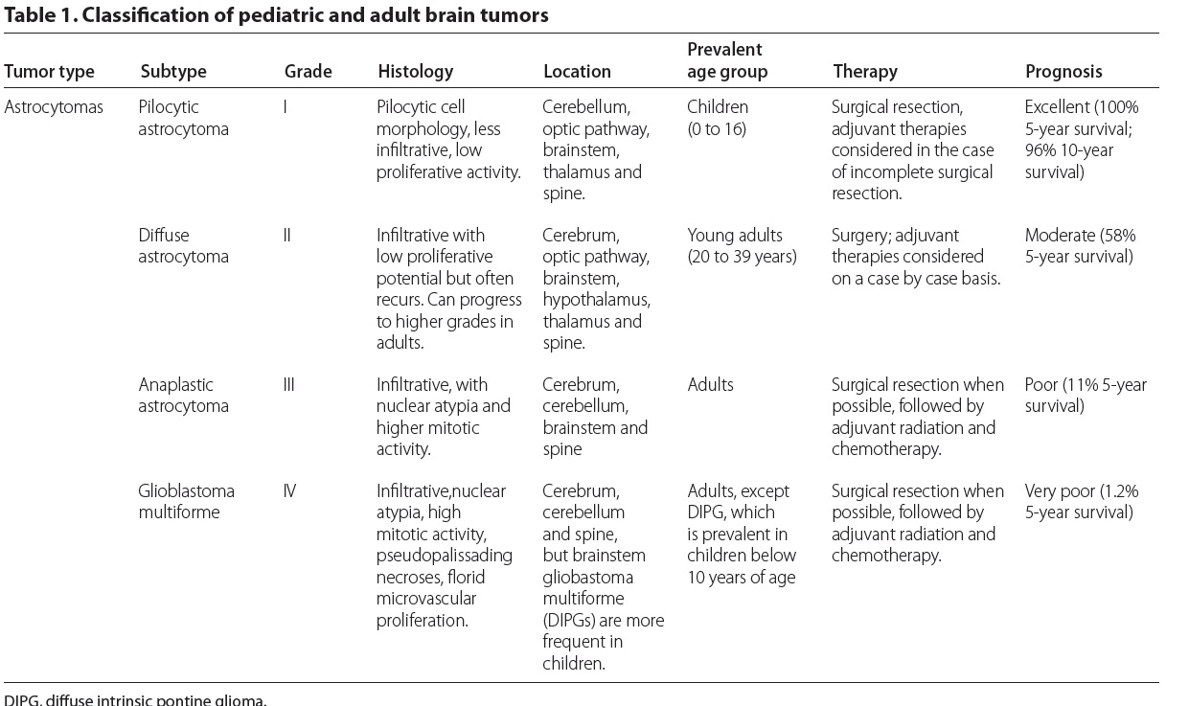
Connecting to clinical data – do astrocytomas show bimodal behavior?
Gerges et al. Genome Medicine 2013, 5:66

Slide 11
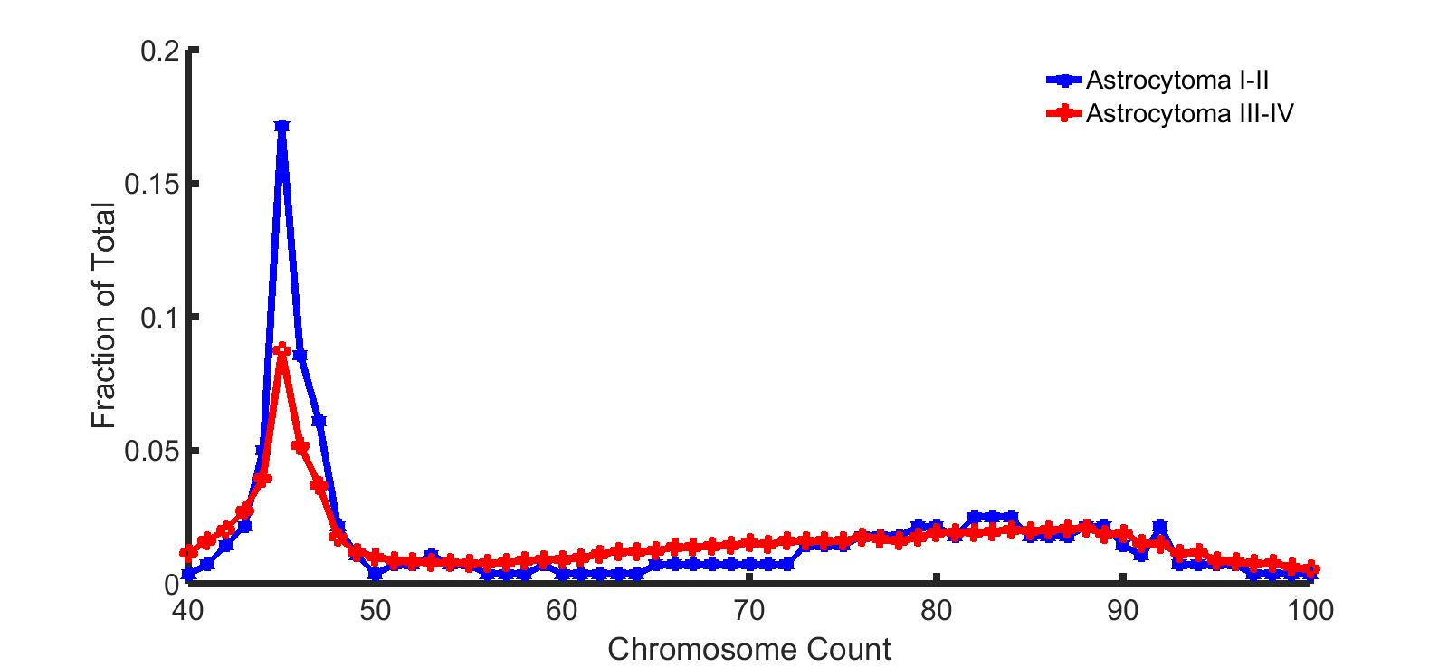
Astrocytomas have bimodal distributions influenced by prognosis

Slide 12
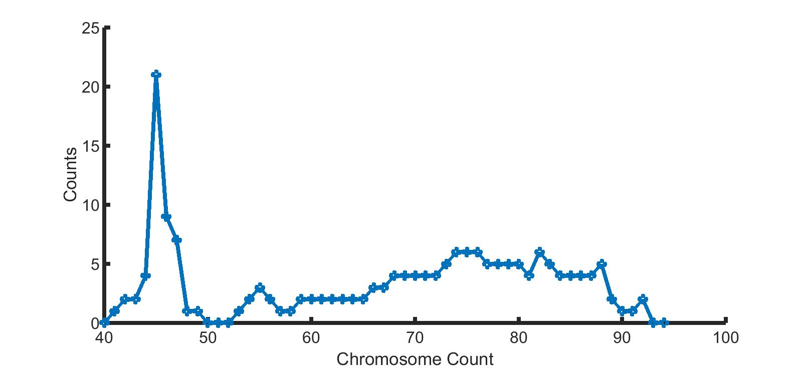
Glioblastoma NOS also bimodal

Slide 13
Extracting fitness landscapes from full chromosome distributions
Previous FISH data: Chr10
Now we have whole chromosome counts – how does this affect fitness for glioblastoma cells?
  Can we understand how underlying fitness contributes to CIN’s “debut”?
  Use previous model

Slide 14
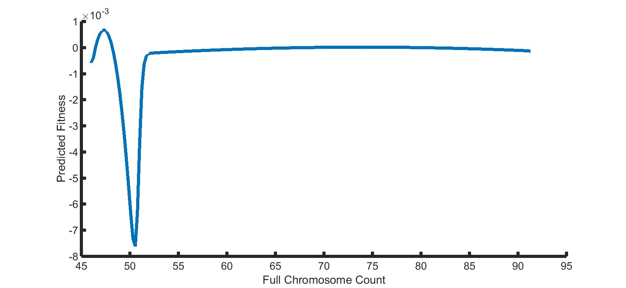
Predicted fitness landscape – potential explanation for tetraploidy initiation?
Notes:
If you’re tetraploid first, you have way more genetic/karyotypic things to discover, as opposed to needing to adapt immediately and make the jump
Neg – pop growth

Slide 15
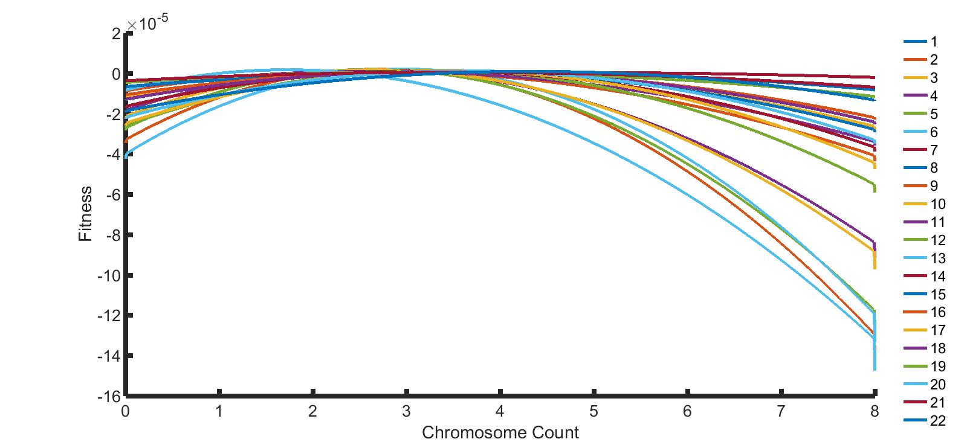
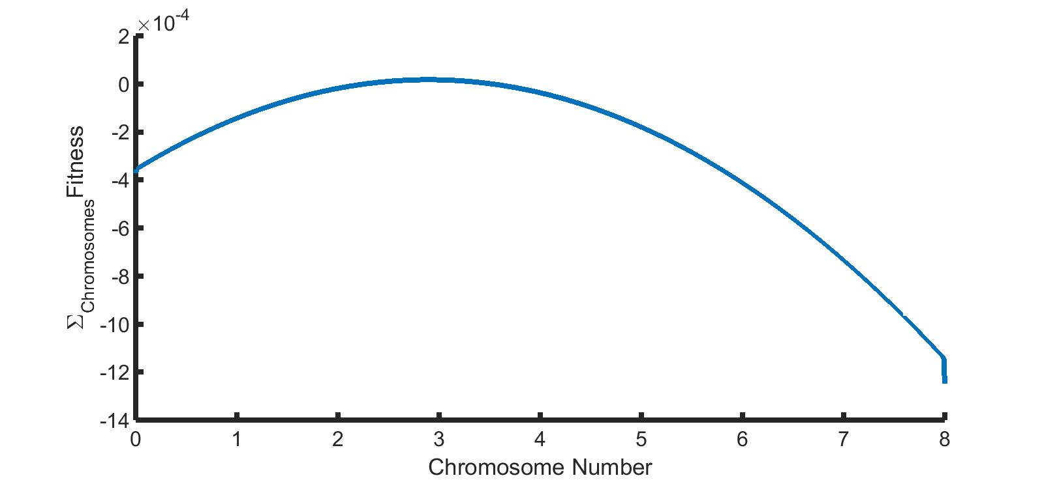
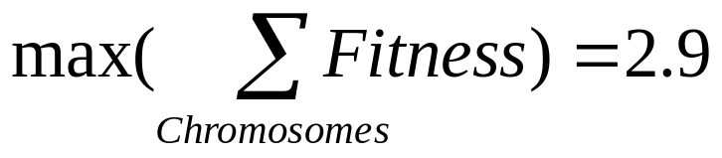
Fitness landscapes for individual chromosomes

Slide 16
Simulating tetraploidy jumps to explain bimodality
m1
m2
m3
. . .
2N-1
2N
2N+1
2N+2
4N
ki

Slide 17
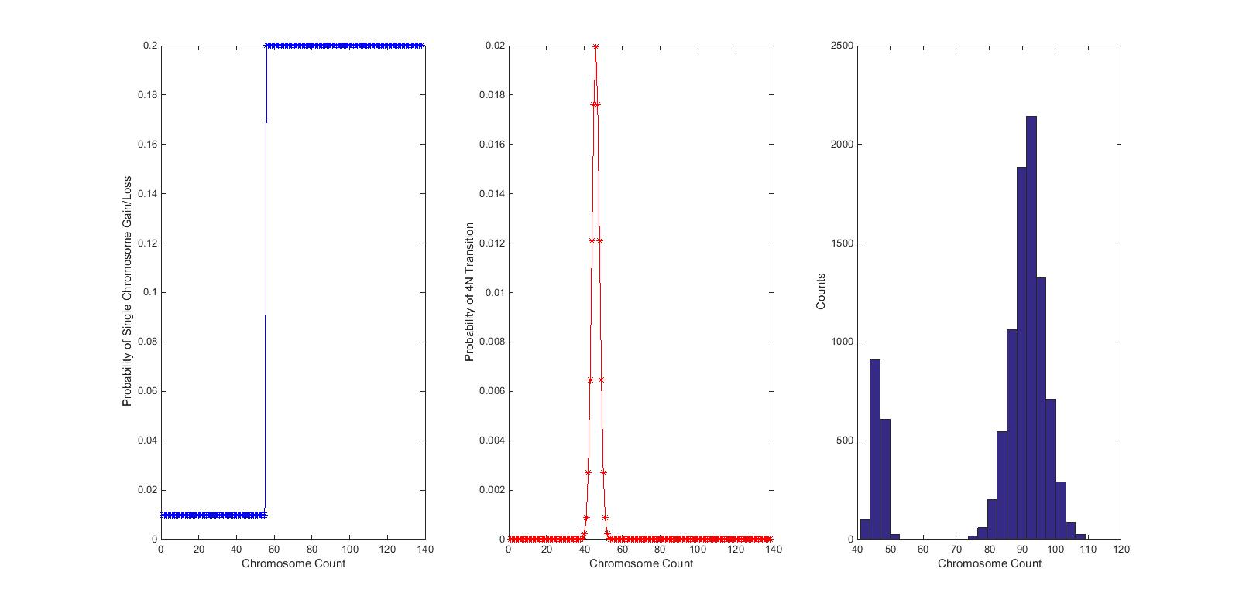
From last week – we can get bimodal distributions

Slide 18
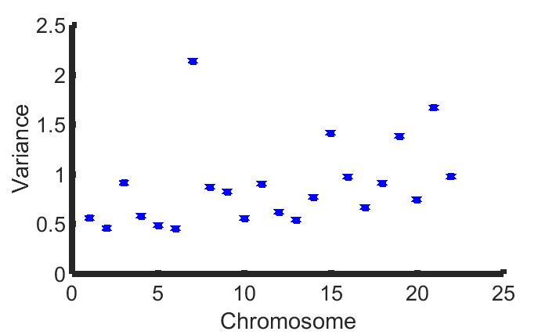
Variance of individual chromosomes
Notes:
Correlation: 0.3569, note weirdness of chromosome 7

Slide 19
These variables are not uncorrelated…
Variance of the sum: 135.5000
Sum of the variances: 19.5033
RMS of individual chromosome variances: 0.9802

